Slide 1


Visualizing
the popularity of content categories

Slide 2


Today's agenda
Project recap
Problem
The Analytics team
Process
Insights
Summary

Slide 3

An analysis of content categories showing the top 5 categories with the largest popularity
Project Recap

Slide 4

Problem
The client has reached a massive scale within recent years and does not have the resources internally to handle it.

Slide 5




Andrew Fleming
(Chief Technical Architect)
The Analytics team
Marcus Rompton (Senior Principle)
David Owino
(Data Analyst)

Slide 6
Process
Analyze the background information provided to understand the requirements
1
2
Identify the right datasets required to answer the client’s business question
3
Clean the datasets and merge them to prepare the data for analysis
4
Model and analyze data to create valuable insights for the client
5
Determine the answer to the client’s business question and present the findings to the client

Slide 7
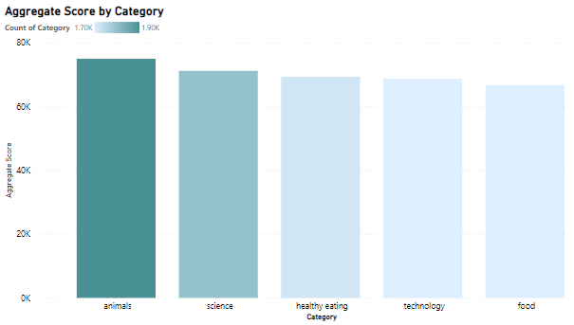

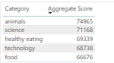
Insights
The top 5 categories are animals, science, healthy eating, technology and food

Slide 8
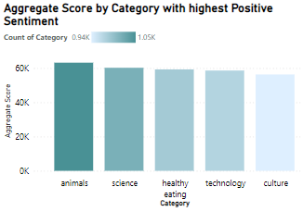
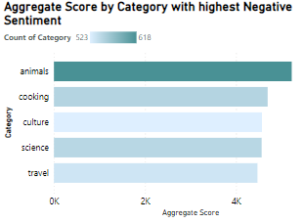
The top 5 categories by Positive and Negative Sentiments

Slide 9
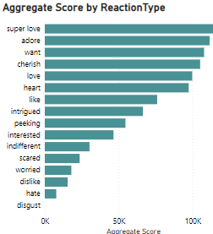
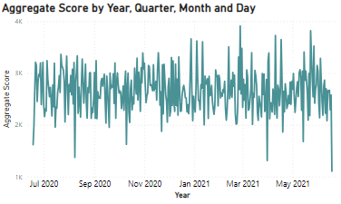
Aggregate Score by Reaction type and Datetime

Slide 10

The top categories in terms of score are animals, science, healthy eating, technology and food
‘animals’ is the top category by positive and negative Sentiments
Summary
The month of May had the highest Positive sentiments, while third quarter had the lowest Negative sentiments

Slide 11
Thank you!
ANY QUESTIONS?

